Slide 1

CD for DBs
Database Deployment Strategies
Chris Fulton, Global Technical Account Manager, Electric Cloud

Slide 2

Evolution of Database Deployments
Manual Prod
Manual DB
Auto DBl
Auto DB++
DB Anywhere
Notes:
History of database deployments
Developer manually changes production databases by hand
Developer manually writes SQL scripts, then runs sql scripts by hand
Developer manually writes SQL scripts, then automatically runs SQL scripts
Uses hammer to run SQL
Developer automatically generates SQL scripts, and uses tool to automatically run them
Sharper tool to be more effitient
Developer moves away from SQL scripts to more advanced methods of deployments and no longer has to worry about them

Slide 3

Why is the Database Important
Contains logic and critical business data
The “brains” of an application
Making changes to a database is much like doing brain surgery
Notes:
Contains logic and critical business data
The “brain” of an application
Maing changes to a database is like doing “brain surgery”

Slide 4

Why is it complicated
More than one application…
Multiple databases per server…
Most critical data…
If you lose data from a database, you lose critical customer data
Ouch. Schema Changes
Notes:
Applications contain files / components / dependencies
Databases contain “the brain” that control all applications
Similar concept to “the borg”
A change in one database can affect many applications
Can affect business data
Not only is your site down, you lost all banking information
Schema Changes – ACID makes it more challenging

Slide 5
Things to consider

Slide 6

Testing
What applications does this deployment affect
What testing should be done (before/during/after)
What do you do if testing breaks
Automated Rollback?
Manual Intervention?
Who decides
Notes:
What applications does this affect
What other tables/db’s are affected
What testing should be done before / during / after deployment
What to do if your testing breaks
Rollback
Manual intervention
Who makes that call (automatically made?
Testing often can’t happen cause you can’t copy the entire database

Slide 7

Rollback
At what point did it fail
Did I corrupt tables
Do I have partially updated data
Is it partially deployed
Was the system running when updating
Do I have some records updated/changed since start
Notes:
At what point did it fail
Did I corrupt tables
Do I have partially updated data
Is it partially deployed
Was the system running when updating
Do I have some records that are updated since I started deployment
Did you lose data in transit

Slide 8

Automation
Who owns the automation?
How does the automation determine success/fail?
What if I do fail?
What tool to use?
Supported features
Automatic Rollback?
Rolling Deployments?
Notes:
Who ownes the automation
How does the automation determine success / failure
What happens if it does fail
What tool to use for automation
Does that tool support features needed
Rollback?
Partial / Rolling deployment

Slide 9

Distributed Development / Infrastructure
How do developers merge code
How do you integrate developers work
How do you handle distributed systems across the world
Notes:
How do developers merge code
What if one portion of the database code is “ready to go” but others aren’t
Do the developers do integrated testing
Distributed Development / Infrastructure – ADD to slides

Slide 10
Methods

Slide 11
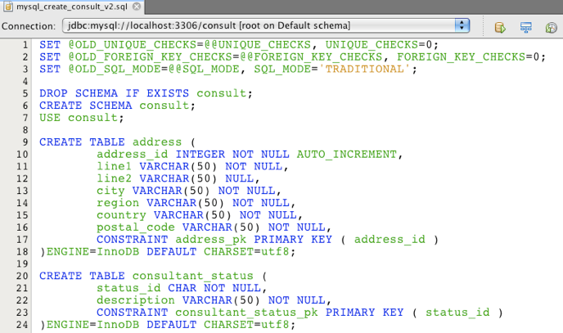
SQL Scripts / Rollback Scripts
Notes:
DB Developer writes a script for deployment and also a script for “undeployment”
Advantages:
Fast deployment (just run SQL script) … when it works
Minimal or no downtime … when it works
Disadvantages
Requires developer to never make mistakes (never happens right!)
How do you TRULY test a rollback – do you even test them? Developer makes no mistakes right?!
Can be error prone …. Unless developer is perfect
How do you merge multiple developers work
Good for:
Simple small databases with small development team

Slide 12

SQL Scripts / Rollback Scripts - Advantages
Fast deployments
Just run a SQL script!
Minimal or no downtime
When it works
Notes:
DB Developer writes a script for deployment and also a script for “undeployment”
Advantages:
Fast deployment (just run SQL script) … when it works
Minimal or no downtime … when it works
Disadvantages
Requires developer to never make mistakes (never happens right!)
How do you TRULY test a rollback – do you even test them? Developer makes no mistakes right?!
Can be error prone …. Unless developer is perfect
How do you merge multiple developers work
Good for:
Simple small databases with small development team

Slide 13

SQL Scripts / Rollback Scripts - Disadvantages
Requires developer to never make mistakes
Requires extensive testing
How to TRULY test rollback
Error prone
How do you merge multiple developers work
Notes:
DB Developer writes a script for deployment and also a script for “undeployment”
Advantages:
Fast deployment (just run SQL script) … when it works
Minimal or no downtime … when it works
Disadvantages
Requires developer to never make mistakes (never happens right!)
How do you TRULY test a rollback – do you even test them? Developer makes no mistakes right?!
Can be error prone …. Unless developer is perfect
How do you merge multiple developers work
Good for:
Simple small databases with small development team

Slide 14
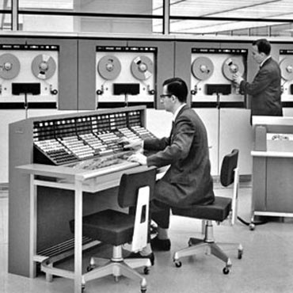
SQL Scripts / Rollback Scripts – Who should use
Small Databases
Small development teams
Simple changes
Legacy Databases
If no other choice
Notes:
DB Developer writes a script for deployment and also a script for “undeployment”
Advantages:
Fast deployment (just run SQL script) … when it works
Minimal or no downtime … when it works
Disadvantages
Requires developer to never make mistakes (never happens right!)
How do you TRULY test a rollback – do you even test them? Developer makes no mistakes right?!
Can be error prone …. Unless developer is perfect
How do you merge multiple developers work
Good for:
Simple small databases with small development team

Slide 15
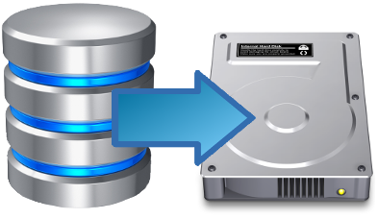
Backup at Deploy
Notes:
At deployment backup, then deploy, then if you need to rollback, restore backup
Adv
Guarantees you are 100% back to previous good state
“Safest” method
Disadvantes
Every application that depends on the database is 100% down during the entire deployment process
Won’t work for sites that always need to be up (What if I am in tokyo and need some money from my bank in the USA but they are down cause they are deploying)
Slower deployments – have to also take into account the time to run the backup before deployment into deploy time. For larger databases this can take hours (or more)
Good for
Small applications with very small databases that can withstand being down for deploy time

Slide 16

Backup at Deploy - Advantages
Guarantees you are 100% back to previous good state
“Safest” technically speaking
Notes:
At deployment backup, then deploy, then if you need to rollback, restore backup
Adv
Guarantees you are 100% back to previous good state
“Safest” method
Disadvantes
Every application that depends on the database is 100% down during the entire deployment process
Won’t work for sites that always need to be up (What if I am in tokyo and need some money from my bank in the USA but they are down cause they are deploying)
Slower deployments – have to also take into account the time to run the backup before deployment into deploy time. For larger databases this can take hours (or more)
Good for
Small applications with very small databases that can withstand being down for deploy time

Slide 17

Backup at Deploy - Disadvantages
Every application that depends on the database is 100% down during deploy
Slower deployments
Notes:
At deployment backup, then deploy, then if you need to rollback, restore backup
Adv
Guarantees you are 100% back to previous good state
“Safest” method
Disadvantes
Every application that depends on the database is 100% down during the entire deployment process
Won’t work for sites that always need to be up (What if I am in tokyo and need some money from my bank in the USA but they are down cause they are deploying)
Slower deployments – have to also take into account the time to run the backup before deployment into deploy time. For larger databases this can take hours (or more)
Good for
Small applications with very small databases that can withstand being down for deploy time

Slide 18

Backup at Deploy – Who should use
Applications that can withstand being down
Smaller databases that backup quickly
Applications that do not share databases
Notes:
At deployment backup, then deploy, then if you need to rollback, restore backup
Adv
Guarantees you are 100% back to previous good state
“Safest” method
Disadvantes
Every application that depends on the database is 100% down during the entire deployment process
Won’t work for sites that always need to be up (What if I am in tokyo and need some money from my bank in the USA but they are down cause they are deploying)
Slower deployments – have to also take into account the time to run the backup before deployment into deploy time. For larger databases this can take hours (or more)
Good for
Small applications with very small databases that can withstand being down for deploy time

Slide 19
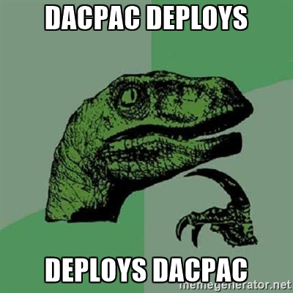
DACPAC
Microsoft’s solution to help solve Database Deployment issues
Profile
How do I run the DACPAC
DACPAC
What changes did I make
Looks at what is on the database currently and compares to changes in DACPAC then applies changes
Notes:
Microsoft’s solution to help solve this
Allows you to have a profile (how do I run the dacpac) and dacpac (changes I made to the database) which then will look at the database on a machine and decide how to merge the changes in your dacpac onto the database on the machine
Advantages
Creates an easy rollback (deploy the previous dacpac …. Automatic in ElectricFlow!!!!)
Works well with multiple developers (since the product will automatically merge the changes)
Disadvantages
Requires well written profile (poorly written profile can cause data loss)
Microsoft only (what if I use Oracle)
Relatively new (what if I have a legacy database)
Good for:
Microsoft shops that use a newer version!!
I would HIGHLY recommend all people that use a newer version of SQLServer to use this method to deploy.

Slide 20

DACPAC - Advantages
Creates easier rollbacks
Deploy the previous DACPAC
ElectricFlow™ lets you do this Automatically!
Works well with multiple developers
Use VisualStudio
Notes:
Microsoft’s solution to help solve this
Allows you to have a profile (how do I run the dacpac) and dacpac (changes I made to the database) which then will look at the database on a machine and decide how to merge the changes in your dacpac onto the database on the machine
Advantages
Creates an easy rollback (deploy the previous dacpac …. Automatic in ElectricFlow!!!!)
Works well with multiple developers (since the product will automatically merge the changes)
Disadvantages
Requires well written profile (poorly written profile can cause data loss)
Microsoft only (what if I use Oracle)
Relatively new (what if I have a legacy database)
Good for:
Microsoft shops that use a newer version!!
I would HIGHLY recommend all people that use a newer version of SQLServer to use this method to deploy.

Slide 21

DACPAC - Disadvantages
Requires well written profile
Poorly written can cause data loss
Microsoft only solution
Not for Oracle or other DB’s
Relatively new
Notes:
Microsoft’s solution to help solve this
Allows you to have a profile (how do I run the dacpac) and dacpac (changes I made to the database) which then will look at the database on a machine and decide how to merge the changes in your dacpac onto the database on the machine
Advantages
Creates an easy rollback (deploy the previous dacpac …. Automatic in ElectricFlow!!!!)
Works well with multiple developers (since the product will automatically merge the changes)
Disadvantages
Requires well written profile (poorly written profile can cause data loss)
Microsoft only (what if I use Oracle)
Relatively new (what if I have a legacy database)
Good for:
Microsoft shops that use a newer version!!
I would HIGHLY recommend all people that use a newer version of SQLServer to use this method to deploy.

Slide 22

DACPAC – Who should use
Microsoft only shops that are on a newer version of SqlServer
All who use a version of SqlServer that supports them
Notes:
Microsoft’s solution to help solve this
Allows you to have a profile (how do I run the dacpac) and dacpac (changes I made to the database) which then will look at the database on a machine and decide how to merge the changes in your dacpac onto the database on the machine
Advantages
Creates an easy rollback (deploy the previous dacpac …. Automatic in ElectricFlow!!!!)
Works well with multiple developers (since the product will automatically merge the changes)
Disadvantages
Requires well written profile (poorly written profile can cause data loss)
Microsoft only (what if I use Oracle)
Relatively new (what if I have a legacy database)
Good for:
Microsoft shops that use a newer version!!
I would HIGHLY recommend all people that use a newer version of SQLServer to use this method to deploy.

Slide 23
Other DB Deployment tools
DBMaestro
Redgate
Many Many more
Notes:
Include a few other tools here

Slide 24
Strategies

Slide 25

Just do it – Deploy all at once
Deploy all at once to all machines
Run individual tests after deployment
Rollback all at once
Notes:
Deploy everything at once

Slide 26
Just do it – Deploy all at once
Advantages
Super fast deployments
On Success, things are already out there
Disadvantages
Dangerous if you have failures
Could bring down entire system
Not a lot of time to test
Not recommended
Notes:
Deploy everything at once
Testing isin production – NOT RECOMMENDED

Slide 27
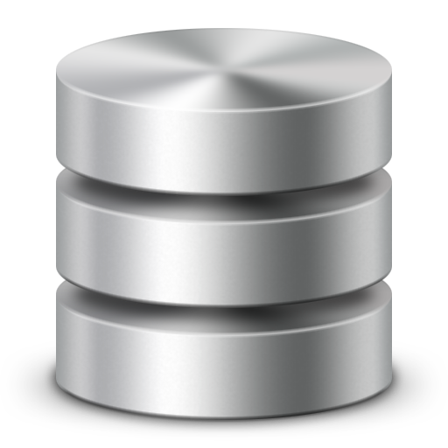

Partial deploy (Canary)
Database Cluster
Application Cluster
Deploy Database Cluster
Deploy Application Cluster
Notes:
Take one machine out of a cluster, deploy to it, wait a week or so then take other machines out
Run extensive testing on a subset of users

Slide 28
Partial Deploy - Advantages
Allows you to test on a subset of users
On failure, you do not bring down everyone. Simply re-point the users on the new deploy cluster back to the original cluster
Allows you to give a “sneak peek” to a subset of users

Slide 29

Partial Deploy - Disadvantages
Can be complex to maintain
Requires more infrastructure to maintain more clusters
Often requires application changes
Requires synchronizing databases

Slide 30
Rolling deployment
Database Cluster
Application Cluster
Test
Notes:
Similar to partial deploy, but don’t create cluster just for deployment
Native in ElectricFlow

Slide 31
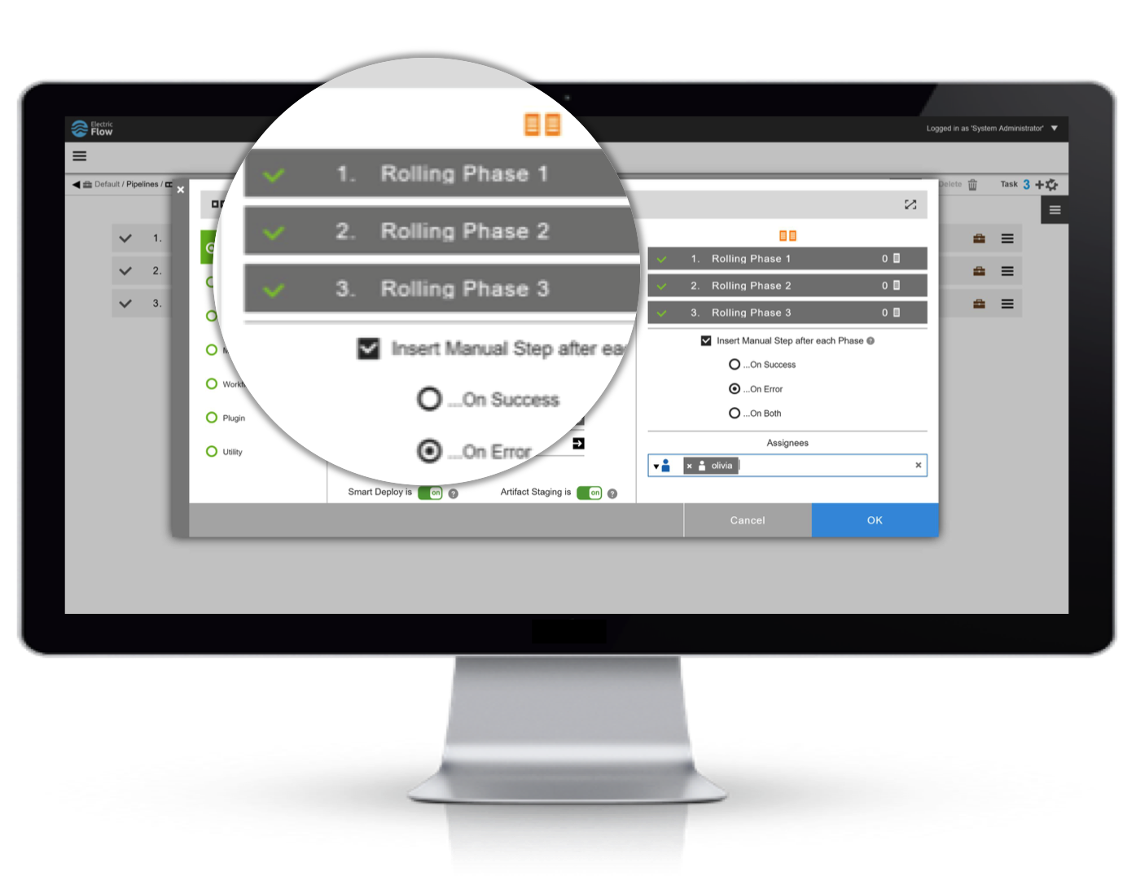
Rolling deployment - Advantages
No clone of infrastructure required
Allows you to do some testing before rolling out to all machines
If something breaks you can simply remove the machines you deployed to from the cluster (little to no downtime)
If you already have a cluster for your DB and Application, little or no changes are required
Natively built into ElectricFlow™

Slide 32
Rolling Deployment - Disadvantages
Version mismatch could cause issues depending on the application and architecture
Requires you to have clustered environment for your DB and Application
(This is a best practice!!!)
Could cause a complex overhead in scripts, unless using a tool like ElectricFlow™

Slide 33
Take Aways

Slide 34
Things to remember
Don’t treat the database as the stepchild
Consider Databases from the start
Different solutions fit different situations
Consider failure when coming up with a deployment strategy
Follow best practices
Backups, Clones, testing failure, etc
Version the database metadata along with the process
Notes:
One size does not fit all.
Depending on needs/database size / application size, different approaches work better for different people
No two companies are alike, but all can share the same common goals
Databases CAN fit in an agile process, with careful planning and preperation

Slide 35
Talk to me
Email: cfulton@electric-cloud.com
LinkedIn: https://www.linkedin.com/in/chrisfulton
Company: http://www.electric-cloud.com
Try us out: http://electric-cloud.com/electricflow/

Slide 36
Thank you!

